Slide 1
Introduction 1 of 2
Had a brother at Khe Sahn
Fighting off the Viet Cong
They're still there, he's all gone
Bruce Springsteen
Born in the U.S.A
Sony Records, 1984

Slide 2


Introduction 2 of 2
The Vietnam Era Twin (VET) Registry:
A 30 Year Compendium of Scientific Research
Jack Goldberg, PhD
Senior Epidemiologist, VET Registry,
Seattle Epidemiologic Research and Information Center,
VA Cooperative Studies Program
Emeritus Research Professor of Epidemiology,
University of Washington

Slide 3
The VET Registry
A Unique Scientific Resource
Many large twin registries in the Nordic countries
    Hundreds of studies of chronic disease and psychiatric conditions
No other national twin registry in the United States

Slide 4
Presentation Outline
History and Development of the VET Registry
  With a few digressions
VET Registry scientific productivity
  Publications
    How many?
    Quality
      Number of citations
      Journal Citation Report

Slide 5
The VET Registry: Development
Concern about the health effects of Agent Orange

Slide 6
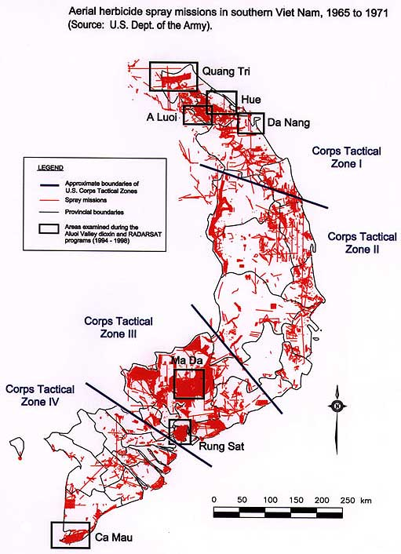
Map of Aerial Herbicide Spray Missions in southern Vietnam

Slide 7
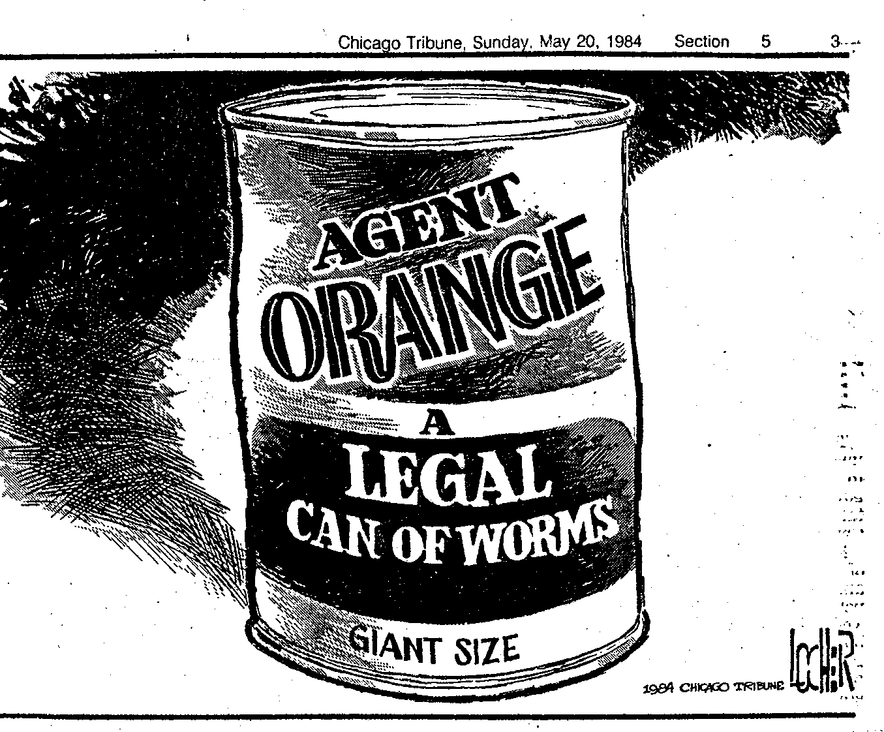
Political cartoon 1 of 3

Slide 8
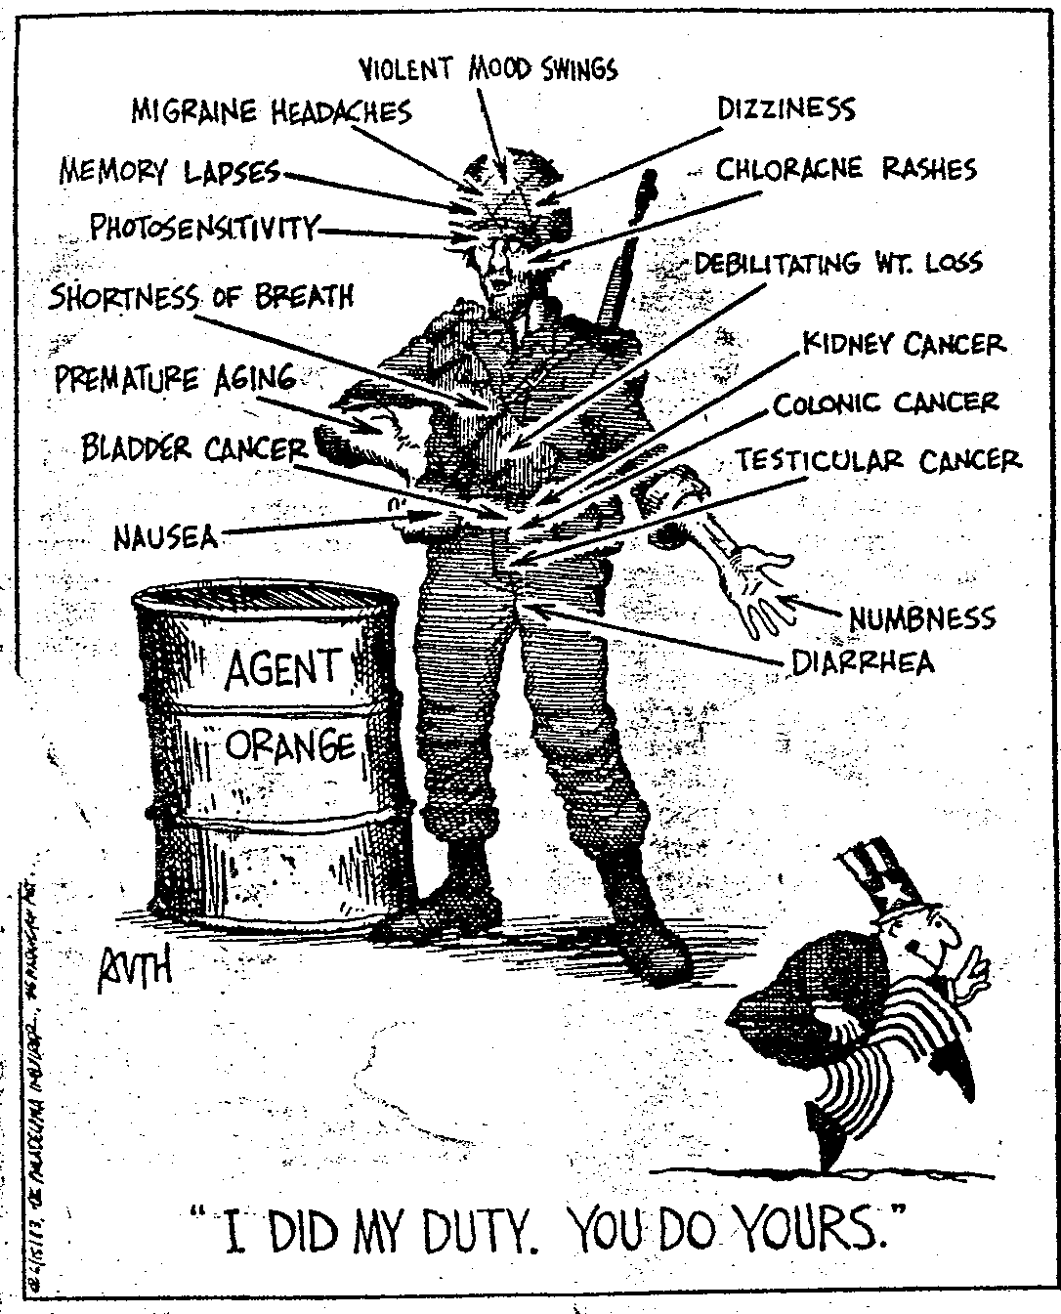
Political cartoon 2 of 3

Slide 9
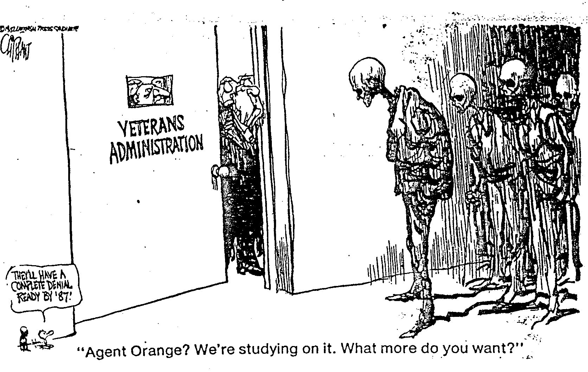
political cartoon 3 of 3

Slide 10
The VET Registry: Development
1 of 7
Research projects into the health of Vietnam veterans by the DoD, VA and CDC
1981 a VA RFP for studies on Agent Orange
  Seth Eisen and William True at the St. Louis VA proposed a co-twin control study

Slide 11
The VET Registry: Development
2 of 7
Proposed study
  Compare health outcomes in 500 male-male monozygotic veteran twin pairs discordant for service in Vietnam
  One brother in Vietnam and a co-twin in the military but did not serve in Vietnam
After much review the VA decides to provide funding for protocol development

Slide 12
The VET Registry: Development
3 of 7
VA Twin Study
  VA Cooperative Studies Program
  Assigned to Hines VA
  Managed by William Henderson, Director of the Hines CSPCC
The project is split
  Agent Orange clinical exam
  Registry component

Slide 13
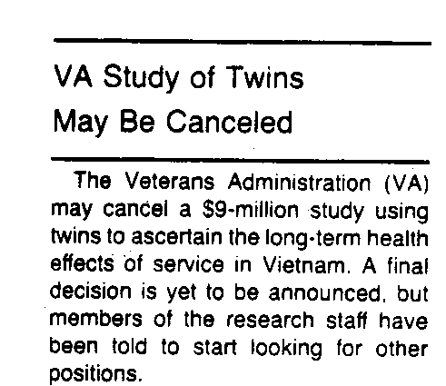
From Science 1984

Slide 14
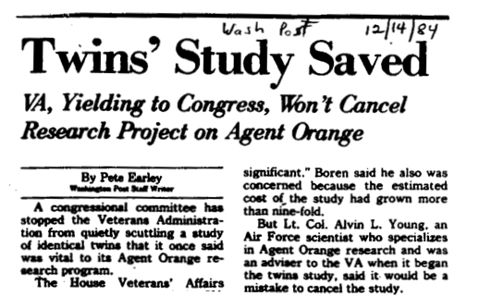
News clipping

Slide 15
The VET Registry: Development
4 of 7
Identifying potential veteran twins by record linkage:
  Same last name, different first name
  Same date of birth (1939-1957)
  Military service between 1965-1975
  Exact match on first 5 digits of the Social Security Number

Slide 16
The VET Registry: Development
5 of 7
~15,000 potential twin pairs are identified
  Retrieve hard copy military records at National Personnel Record Center
    Confirm twinship
    Abstract military record data

Slide 17

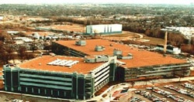
Images of records storage
National Personnel Records Center

Slide 18

Seven Shelf-Miles of Vietnam-Era Records
Scene from “Raiders of the Lost Ark” (1981)

Slide 19
The VET Registry: Development
6 of 7
~7,500 twin pairs identified!!!!!
Military record info
  Branch of service
  Date of enlistment and discharge
  Place of service
  Height and weight
  Measure of general intelligence
  Combat-related medals

Slide 20
The VET Registry: Development
7 of 7
Descriptive Statistics
Median year of birth = 1949
92% white
Vietnam service
  21% both served in Vietnam
  36% discordant for Vietnam
  43% neither served in Vietnam

Slide 21
The VET Registry: Some History
Time at Hines VA CSPCC
Early Hines years (1983-1990)
  CSP # 256 (Vietnam Era Twin Study) is completed
  Registry evolves under Bill Henderson
Later Hines years (1991-2000)
  Strong VA support
  Creation of an external scientific oversight group
  Develop rules for accessing the Registry
  Active research portfolio by investigators
    Mail and telephone surveys
    First in-person examinations (1996)
    Offspring of twins added to Registry (1998)

Slide 22
The VET Registry: More History
Time at Seattle VA CSPEC (2001-2018)
Registry is transferred within CSP to Seattle VA CSPEC
  Jack Goldberg transfers with the Registry
  Registry Director is Ed Boyko and then Nick Smith
Mail and telephone studies continue
In-person studies accelerate
Creation of the Registry biorepository (2002)

Slide 23
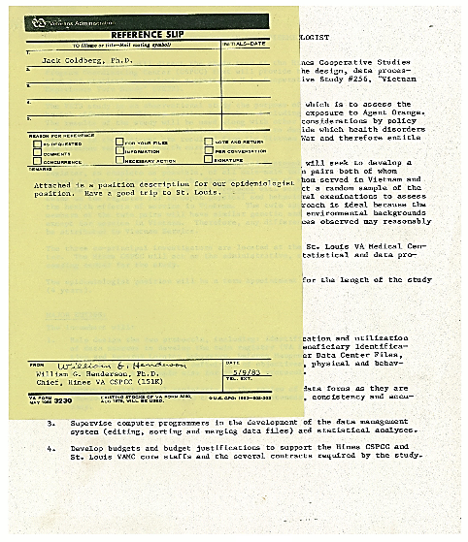
Digression: Memories of the Early Days
(1983)
Epidemiologist job description at Hines for twin study

Slide 24
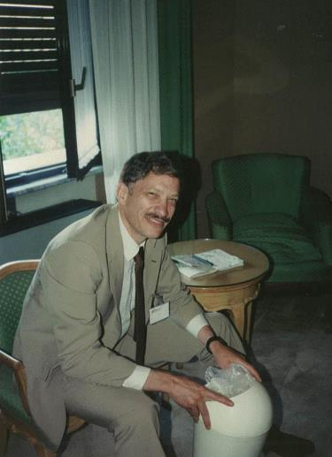
Digression: Memories of the Early Days
1 of 4
(1989)
Seth Eisen in Rome for the International Congress on Twin Studies meeting. He is digging through the hotel waste basket for his misplaced presentation slides.

Slide 25
Digression: Memories of the Early Days
2 of 4
(1988)
Spark for the NHLBI study

Slide 26
Digression:
Memories of the Early Days
(1992)
Harvard Drug Study team –William True, Michael Lyons, Seth Eisen, Nong Lin, Jack Goldberg

Slide 27
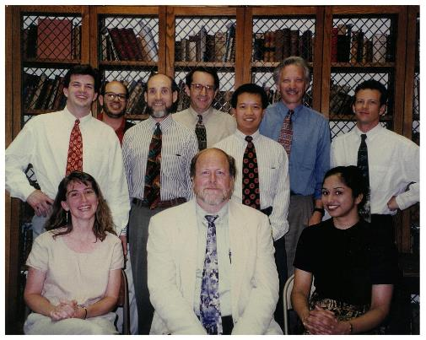
Digression:
Memories of the Early Days
3 of 4
(1996)
Alcohol Vulnerability Study Kick-off Meeting, Boston, MA
Back Row: Tom Doyle, Jack Goldberg, William Kremen, William True, Nong Lin, Seth Eisen,
Mike Neale
Front row: Rosemary Toomey, Michael Lyons, Krupa

Slide 28
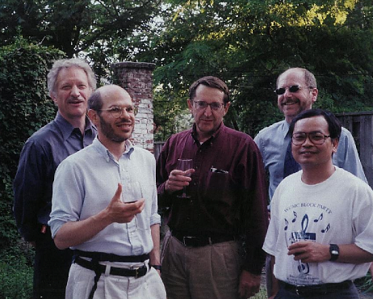
Digression:
Memories of the Early Days
5 of 4
(2002)
Vietnam-Era Twin Study of Aging team -
Seth Eisen, Jack Goldberg, William True, Michael Lyons, Hong Xian

Slide 29
Vietnam-Era Twin (VET) Registry Mission
To promote and advance high-quality scientific research in partnership with Vietnam-era Veteran twins and their families
To maintain a secure and current Registry database and biospecimen repository as a resource for future studies
To treat Registry members and their families with respect and maintain their confidentiality

Slide 30
Methods for Assessing VET Registry Productivity
1 of 2
Search PubMed and Google Scholar for all peer-reviewed VET Registry papers
  Create bibliographic database
    Categorize each paper
      Study team: Harvard Drug, Vietnam-Era Twin Study of Aging, Twin Heart, Pitman/Gilbertson/Shin PTSD, Jacob/Buchloz Offspring and Substance Use
      Twin or offspring
      Data collection: self-report, in-person, biological, imaging
      Topic: mental health, PTSD, physical health, substance use

Slide 31
Methods for Assessing VET Registry Productivity
2 of 2
Measures of impact
  Total number of citations to a VET Registry paper according to Google Scholar as of May 2018
  H-index: based on the set of most cited papers and the number of citations that they have been cited in other publications. The index can be applied to the productivity of a group of scientists.
  Journal Citation Report (JCR)
    A measure reflecting the yearly average number of citations to recent articles published in that journal (equal to the number of current year citations to all papers published in that journal during the previous two years).
    Examples of 2016 JCR: NEJM = 72.4, JAMA = 44.4, JAMA Psychiatry = 15.3, American Journal of Epidemiology = 4.8, Twin Research = 1.3

Slide 32
VET Registry Productivity
Number of VET Registry papers: 304
  52 papers with a focus on PTSD
Total number of citations to VET Registry papers: 23,195
H-index for VET Registry papers: 81
Mean and Median JCR for VET Registry papers: mean = 5.3, median = 3.4

Slide 33
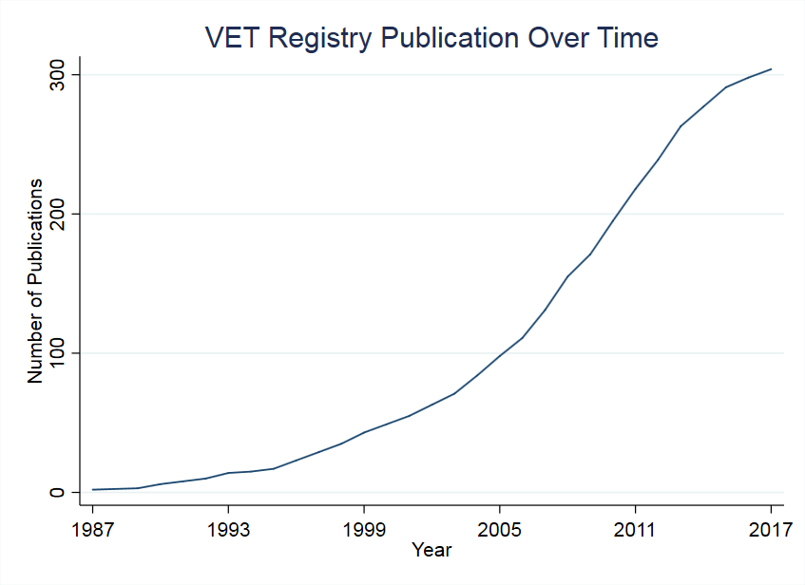
Graph 1 of 6
Cumulative Number of VET Registry Papers

Slide 34
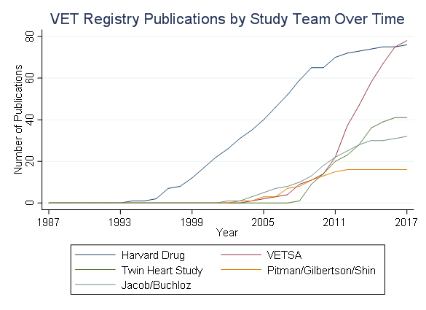
Graph 2 of 6
Cumulative Number of VET Registry Papers by Study Team

Slide 35
Graph 3 of 6
Cumulative Number of VET Registry Papers by Twin vs Offspring

Slide 36
Graph 4 of 6
Cumulative Number of VET Registry Papers
by Data Collection Method

Slide 37
Graph 5 of 6
Cumulative Number of VET Registry Papers by Topic

Slide 38
Graph 6 of 6
Cumulative Number of VET Registry Citations

Slide 39
Top Ten Most Cited Papers: VET Registry
TITLE | CITED BY | YEAR
Smaller hippocampal volume predicts pathologic vulnerability to psychological trauma MW Gilbertson, ME Shenton, A Ciszewski, K Kasai, NB Lasko, SP Orr, … Nature neuroscience 5 (11), 1242 | 1470 | 2002
A twin study of genetic and environmental contributions to liability for posttraumatic stress symptoms WR True, J Rice, SA Eisen, AC Heath, J Goldberg, MJ Lyons, J Nowak Archives of general psychiatry 50 (4), 257-264 | 768 | 1993
Co-occurrence of abuse of different drugs in men: the role of drug-specific and shared vulnerabilities MT Tsuang, MJ Lyons, JM Meyer, T Doyle, SA Eisen, J Goldberg, W True, … Archives of general psychiatry 55 (11), 967-972 | 670 | 1998
Distinct genetic influences on cortical surface area and cortical thickness MS Panizzon, C Fennema-Notestine, LT Eyler, TL Jernigan, … Cerebral cortex 19 (11), 2728-2735 | 610 | 2009
Common genetic vulnerability for nicotine and alcohol dependence in men WR True, H Xian, JF Scherrer, PAF Madden, KK Bucholz, AC Health, … Archives of general psychiatry 56 (7), 655-661 | 535 | 1999
Genetic influences on DSM-III-R drug abuse and dependence: a study of 3,372 twin pairs MT Tsuang, MJ Lyons, SA Eisen, J Goldberg, W True, N Lin, JM Meyer, … American journal of medical genetics 67 (5), 473-477 | 498 | 1996
Common genetic vulnerability for pathological gambling and alcohol dependence in men WS Slutske, S Eisen, WR True, MJ Lyons, J Goldberg, M Tsuang Archives of general psychiatry 57 (17, 666-673 | 413 | 2000
Differential heritability of adult and juvenile antisocial traits MJ Lyons, WR True, SA Eisen, J Goldberg, JM Meyer, SV Faraone, … Archives of general psychiatry 52 (11), 906-915 | 379 | 1995
Sexual orientation and suicidality: a co-twin control study in adult men R Herrell, J Goldberg, WR True, V Ramakrishnan, M Lyons, S Eisen, … Archives of general psychiatry 56 (10), 867-874 | 336 | 1999
Genetic and environmental contributions to smoking WR True, AC Heath, JF Scherrer, B Waterman, J Goldberg, N Lin, … Addiction 92 (10), 1277-1287 | 306 | 1997

Slide 40
Top Ten Most Highly Rated Journals for VET Registry Papers
Journal Title | Journal Citation Reports (JCR) | Number of Papers
JAMA-JOURNAL OF THE AMERICAN MEDICAL ASSOCIATION | 44.4 | 1
SCIENCE | 37.2 | 1
JOURNAL OF THE AMERICAN COLLEGE OF CARDIOLOGY | 19.9 | 2
CIRCULATION | 19.3 | 1
NATURE NEUROSCIENCE | 17.8 | 1
JAMA Internal Medicine | 16.5 | 3
JAMA Psychiatry | 15.3 | 19
AMERICAN JOURNAL OF PSYCHIATRY | 14.2 | 2
NEURON | 14.0 | 1
MOLECULAR PSYCHIATRY | 13.2 | 1

Slide 41
Top Fifteen Authors of VET Registry Papers
Author | Total # of Papers
Lyons, MJ | 159
Goldberg, J | 121
Eisen, SA | 109
Tsuang, MT | 101
Xian, H | 91
Kremen, WS | 90
Franz, CE | 78
True, WR | 75
Panizzon, MS | 68
Scherrer, JF | 62
Jacobson, KC | 46
Vaccarino, V | 45
Bucholz, KK | 43
Grant, MD | 40
Jacob, T | 36

Slide 42
Table 1 of 1
Mean and Median Number of Citations by Study Characteristics
Study characteristics | N | Mean | Median
Study Type
Twin | 272 | 79 | 40
Mother/Offspring | 24 | 49 | 29
Data Type
Self-reported | 232 | 86 | 44
In-person | 142 | 57 | 24
Biological | 107 | 64 | 24
Imaging | 57 | 80 | 29
Outcomes
Mental health | 183 | 82 | 41
PTSD | 62 | 108 | 61
Physical health | 103 | 44 | 30
Substance use | 90 | 88 | 43
Study Group
Harvard Drug | 74 | 137 | 78
VETSA | 84 | 37 | 19
Twin Heart Study | 40 | 50 | 39
Pitman/Gilbertson/Shin | 15 | 180 | 79
Jacob/Buchloz | 32 | 43 | 29

Slide 43
Table 2 of 2
Mean and Median Journal Citation Report by Study Characteristics
Study characteristics | N | Mean | Median
Study Type
Twin | 272 | 5.5 | 3.7
Mother/Offspring | 24 | 3.6 | 2.9
Data Type
Self-reported | 232 | 5.3 | 3.3
In-person | 142 | 5.8 | 4.2
Biological | 107 | 6.3 | 4.5
Imaging | 57 | 7.3 | 5.5
Outcomes
Mental health | 183 | 5.6 | 3.4
PTSD | 62 | 6.3 | 3.3
Physical health | 103 | 5.9 | 4.2
Substance use | 90 | 4.3 | 2.9
Study Group
Harvard Drug | 74 | 5.4 | 3.2
VETSA | 84 | 4.8 | 3.4
Twin Heart Study | 40 | 6.4 | 4.5
Pitman/Gilbertson/Shin | 15 | 8.0 | 5.4
Jacob/Buchloz | 32 | 3.3 | 2.6

Slide 44
Productivity Summary
The VET Registry is an amazing scientific resource
  A large number of papers in high quality scientific journals
  VET Registry papers are widely cited
  Fundamental discoveries about PTSD, substance use disorders, aging, cognition and heart disease

Slide 45
The Future
The best is yet to come
  The Registry is thriving
  Twins are aging
  Data repository is superbly curated
  Biorepository with nearly 2000 samples and growing
    Whole Genome Sequencing on 1749 individuals

Slide 46
Specific thanks-today’s talk:
Chris Forsberg, MS, Biostatistican
Erin Acosta, MPH, Research Assistant
Shauna Biggs, MPH, Research Coordinator
CSP Seattle Epidemiologic Research and Information Center (ERIC)
VA Puget Sound Health Care System

Slide 47
And a Grand Thanks to: 1 of 4
THE VET REGISTRY TWINS!!!!!!!!

Slide 48
And a Grand Thanks to: 2 of 4
VA COOPERATIVE STUDIES PROGRAM

Slide 49
And a Grand Thanks to: 3 of 4
VET REGISTRY DIRECTORS:
William G. Henderson, PhD; Edward J. Boyko, MD, MPH; Nicholas L. Smith, PhD

Slide 50
And a Grand Thanks to: 4 of 4
All OF THE VET REGISTRY STAFF 1983-2018
Bill Henderson, Ed Boyko, Nick Smith

